Slide 1

MediVerse: Enhancing Healthcare with Automation and AI
This document outlines the vision and proposed features of MediVerse, a Smart Hospital System designed to revolutionize healthcare delivery through advanced automation and artificial intelligence. By streamlining operations and enhancing patient engagement, MediVerse aims to create a more efficient, compassionate, and accessible healthcare environment for all.

Slide 2
The Imperative for a Smart Hospital System
"Healthcare faces increasing demands for efficiency, accessibility, and personalized care. Traditional manual processes often lead to bottlenecks, errors, and diminished patient satisfaction. A smart hospital system is not merely an upgrade; it's a necessity for the future of healthcare."
What is MediVerse?
Why is it Needed?
MediVerse is an integrated digital platform that leverages automation and AI to optimize various hospital services. It aims to create a seamless experience for patients, medical staff, and administrators by digitizing workflows, improving communication, and providing intelligent support.
Alleviates administrative burden on medical staff.
Reduces patient wait times and improves access to care.
Minimizes human error in critical processes.
Enhances overall patient safety and satisfaction.
Enables data-driven decision-making for hospital management.

Slide 3
Core Objectives of the MediVerse Project
Automate Hospital Services
Improve Patient Care Experience
Reduce Manual Processes
Streamline routine administrative and operational tasks to reduce manual effort and improve efficiency. This includes patient registration, scheduling, and internal requests.
Enhance the quality and accessibility of patient care through faster service delivery, personalized interactions, and proactive support systems.
Eliminate paper-based systems and repetitive manual tasks, freeing up healthcare professionals to focus on direct patient interaction and critical medical duties.
These objectives form the bedrock of MediVerse, guiding every feature and development decision towards a more advanced and patient-centric healthcare ecosystem.

Slide 4
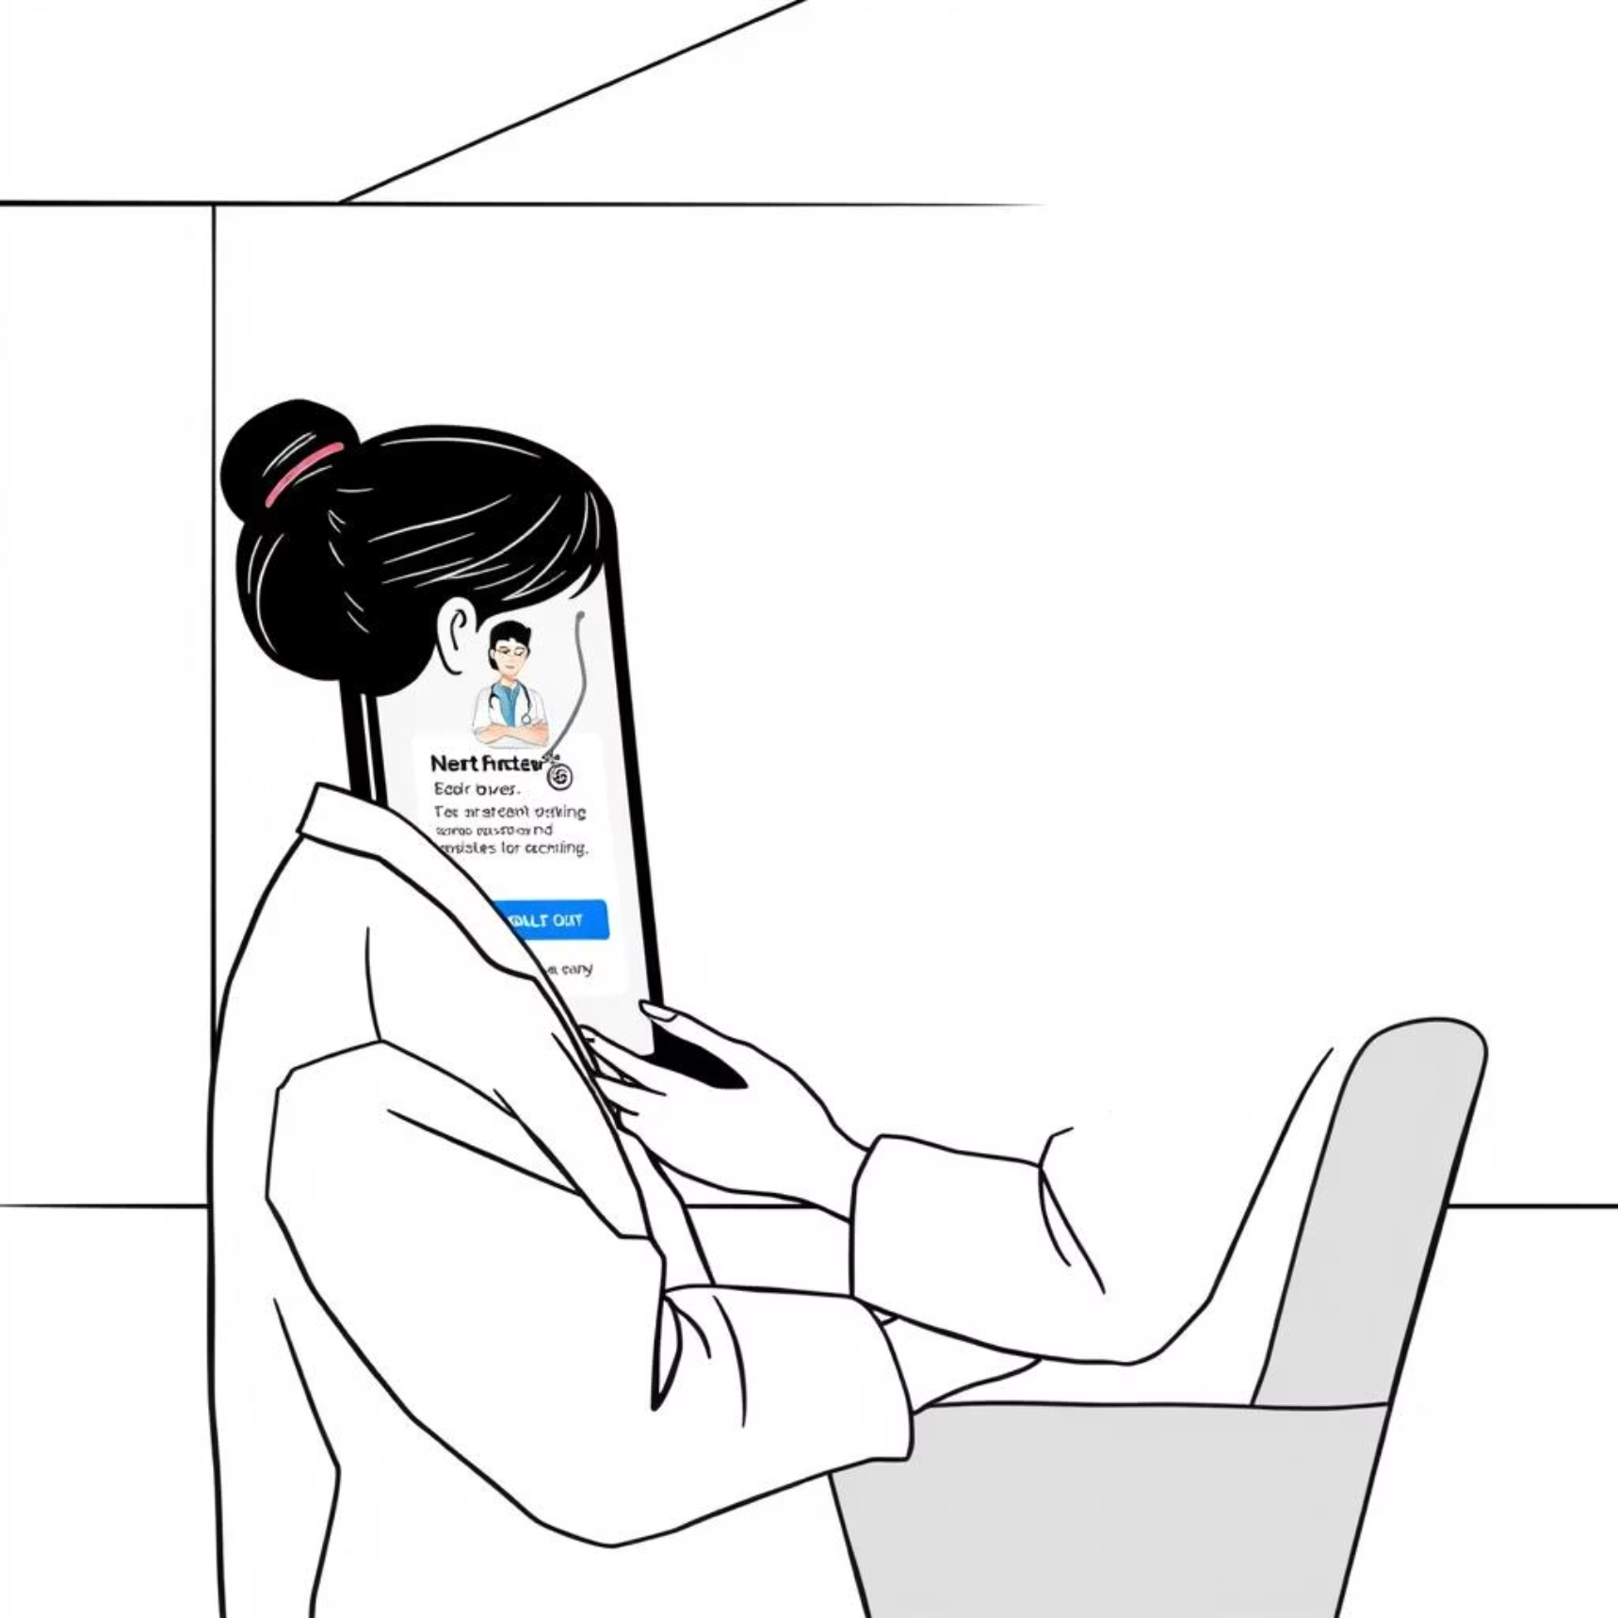
Streamlined Patient Access: Online OP Booking & Chatbot Integration
Online OP (Out-Patient) Booking
24/7 Accessibility: Patients can book, reschedule, or cancel appointments anytime, anywhere.
Real-time Availability: View doctor schedules and available slots instantly.
Reduced Wait Times: Optimized scheduling leads to smoother clinic flow.
Chatbot Integration
Instant Support: Automated responses to common patient queries about services, directions, or procedures.
Appointment Assistance: Guides users through the booking process or helps with queries related to existing appointments.
Multilingual Support: Future potential for diverse patient populations.
This dual approach significantly improves patient convenience and reduces the load on administrative staff.

Slide 5

Empowering Clinicians: The Doctor Dashboard
The Doctor Dashboard is a centralized hub designed to provide medical professionals with immediate access to crucial patient information, schedules, and communication tools. This feature significantly enhances their efficiency and ability to deliver focused care.
Unified Patient View: Access patient history, current vitals, medication lists, and lab results in one place.
Optimized Schedules: View daily appointments, manage patient queues, and receive alerts for urgent cases.
Task Management: Assign and track tasks for nurses and support staff, ensuring seamless workflow.
Secure Communication: Integrated messaging for internal team collaboration.

Slide 6


Seamless Internal Operations: Room-to-Room Patient Transfer & Medical Forms
Room-to-Room Patient Transfer Workflow
Digitized Medical Forms
Automated tracking and notification system for patient transfers between different rooms or departments. This minimizes delays, ensures proper patient handover, and maintains continuity of care. It includes real-time updates for receiving staff and necessary equipment preparations.
Convert all hospital forms (admission, consent, discharge, etc.) into digital formats. This reduces paper consumption, eliminates data entry errors, and allows for instant access and secure storage. Digital signatures and automated routing further enhance efficiency.

Slide 7
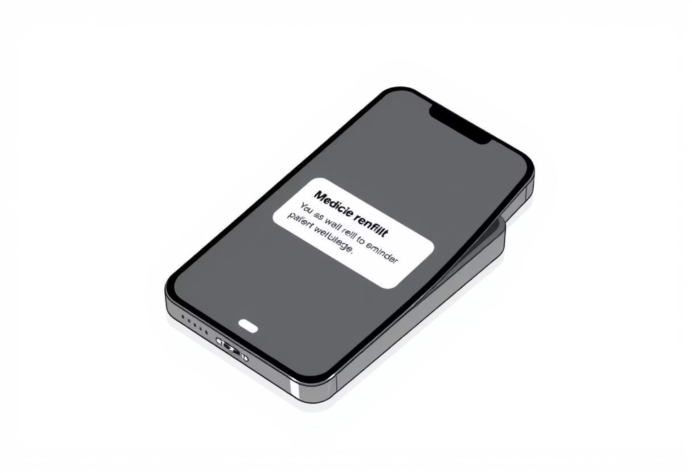

Proactive Patient Engagement: Reminders & SOS Support
Medicine Refill Reminders
SOS Button (Emergency Support)
Automated Notifications: Patients receive timely alerts for medication refills via SMS or app notifications.
Instant Alerts: A dedicated button for patients to summon immediate emergency assistance from hospital staff.
Adherence Support: Improves patient adherence to prescribed medication regimens, leading to better health outcomes.
Location Tracking: Staff are alerted to the exact room location, ensuring rapid response.
Pharmacy Integration: Potential for direct refill requests and pick-up scheduling.
Enhanced Safety: Provides peace of mind for patients and ensures critical situations are addressed swiftly.

Slide 8


Intelligent Assistance: AI Chatbot & Room Booking
AI Chatbot for Support and Queries
Room Booking via Catalog
Simplify the process of booking hospital rooms (e.g., for specific procedures, recovery, or temporary stays) through a centralized, user-friendly catalog interface. This automates the allocation process, reduces manual errors, and optimizes bed management efficiency.
Beyond appointment booking, the AI chatbot serves as a comprehensive support system. It can answer frequently asked questions, provide information on hospital services, guide patients to relevant departments, and even assist with minor technical issues related to the system.

Slide 9
The Power Behind MediVerse: Technology Stack
MediVerse is built upon a robust and scalable technology stack, leveraging industry-leading platforms to ensure reliability, security, and seamless integration across all functionalities.
ServiceNow Platform
Workflow Designer
Virtual Agent
The core foundation, providing a comprehensive cloud-based platform for IT service management, enterprise workflow automation, and custom application development.
Enables the creation of complex, automated workflows for various hospital processes, from patient admissions to internal transfers, ensuring efficiency and compliance.
Powers the AI Chatbot, offering conversational interfaces for patients and staff, driven by natural language processing and machine learning capabilities.
Notifications Module
Service Catalogs
Custom Integrations
Handles all automated alerts and reminders, ensuring timely communication for appointments, medication refills, and critical updates.
Provides a user-friendly interface for requesting and booking various hospital services, including rooms and equipment.
Designed for seamless integration with existing hospital information systems (HIS) and electronic health records (EHR) for a unified data ecosystem.

Slide 10

Conclusion & Future Scope
MediVerse, developed by Tech Titans, represents a significant leap forward in modernizing healthcare. By automating routine tasks and integrating AI, we are not just improving efficiency but profoundly enhancing the patient experience and empowering healthcare professionals. The initial phase focuses on core functionalities, laying a strong foundation for future advancements.
Future Scope:
Predictive Analytics: Leveraging patient data to predict potential health risks or resource needs.
Telemedicine Integration: Seamless virtual consultations and remote monitoring.
Personalized Health Journeys: Tailored patient pathways and education based on individual needs.
Project MediVerse: Innovating Healthcare, Together.
IoT Integration: Smart devices for real-time patient monitoring and environmental control within rooms.
Advanced AI Diagnostics: AI-powered assistance for faster and more accurate diagnoses.

